Slide 1
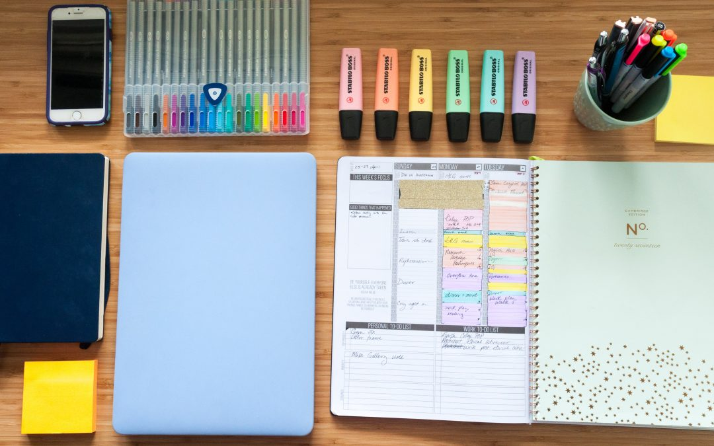

Developed By:
Bhargavi K. Sundaresan
Le Minh Long Nguyen
Sarthak Agarwal
Yunlin Xie
Xin Xin

Slide 2

Contents of the presentation:
Our Topic
2) Data and its Credibility
3) Data Structures and UML diagrams
Data structure for product
Data structure for order
Data structure for customer
4) Results and Modifications from BETA testing
5) Live Demo

Slide 3
Our Topic:
An e-commerce store for COLLEGE SUPPLIES.
We as college going students always struggle with basic supplies like stationary, furniture, table lamps, desk accessories, etc.
We would apply various data structures and techniques to come up with an app that would help college students to buy the college supplies without any hassle.

Slide 4
Data and its Credibility:
Our DATA set is a collection of college supplies like stationery, furniture and other basic supplies.
Some examples of products(Notebook, Pencils, etc)
This is where we found majority of our data ideas.
URL:https://bigfuture.collegeboard.org/get-in/making-a-decision/off-to-college-checklist

Slide 5
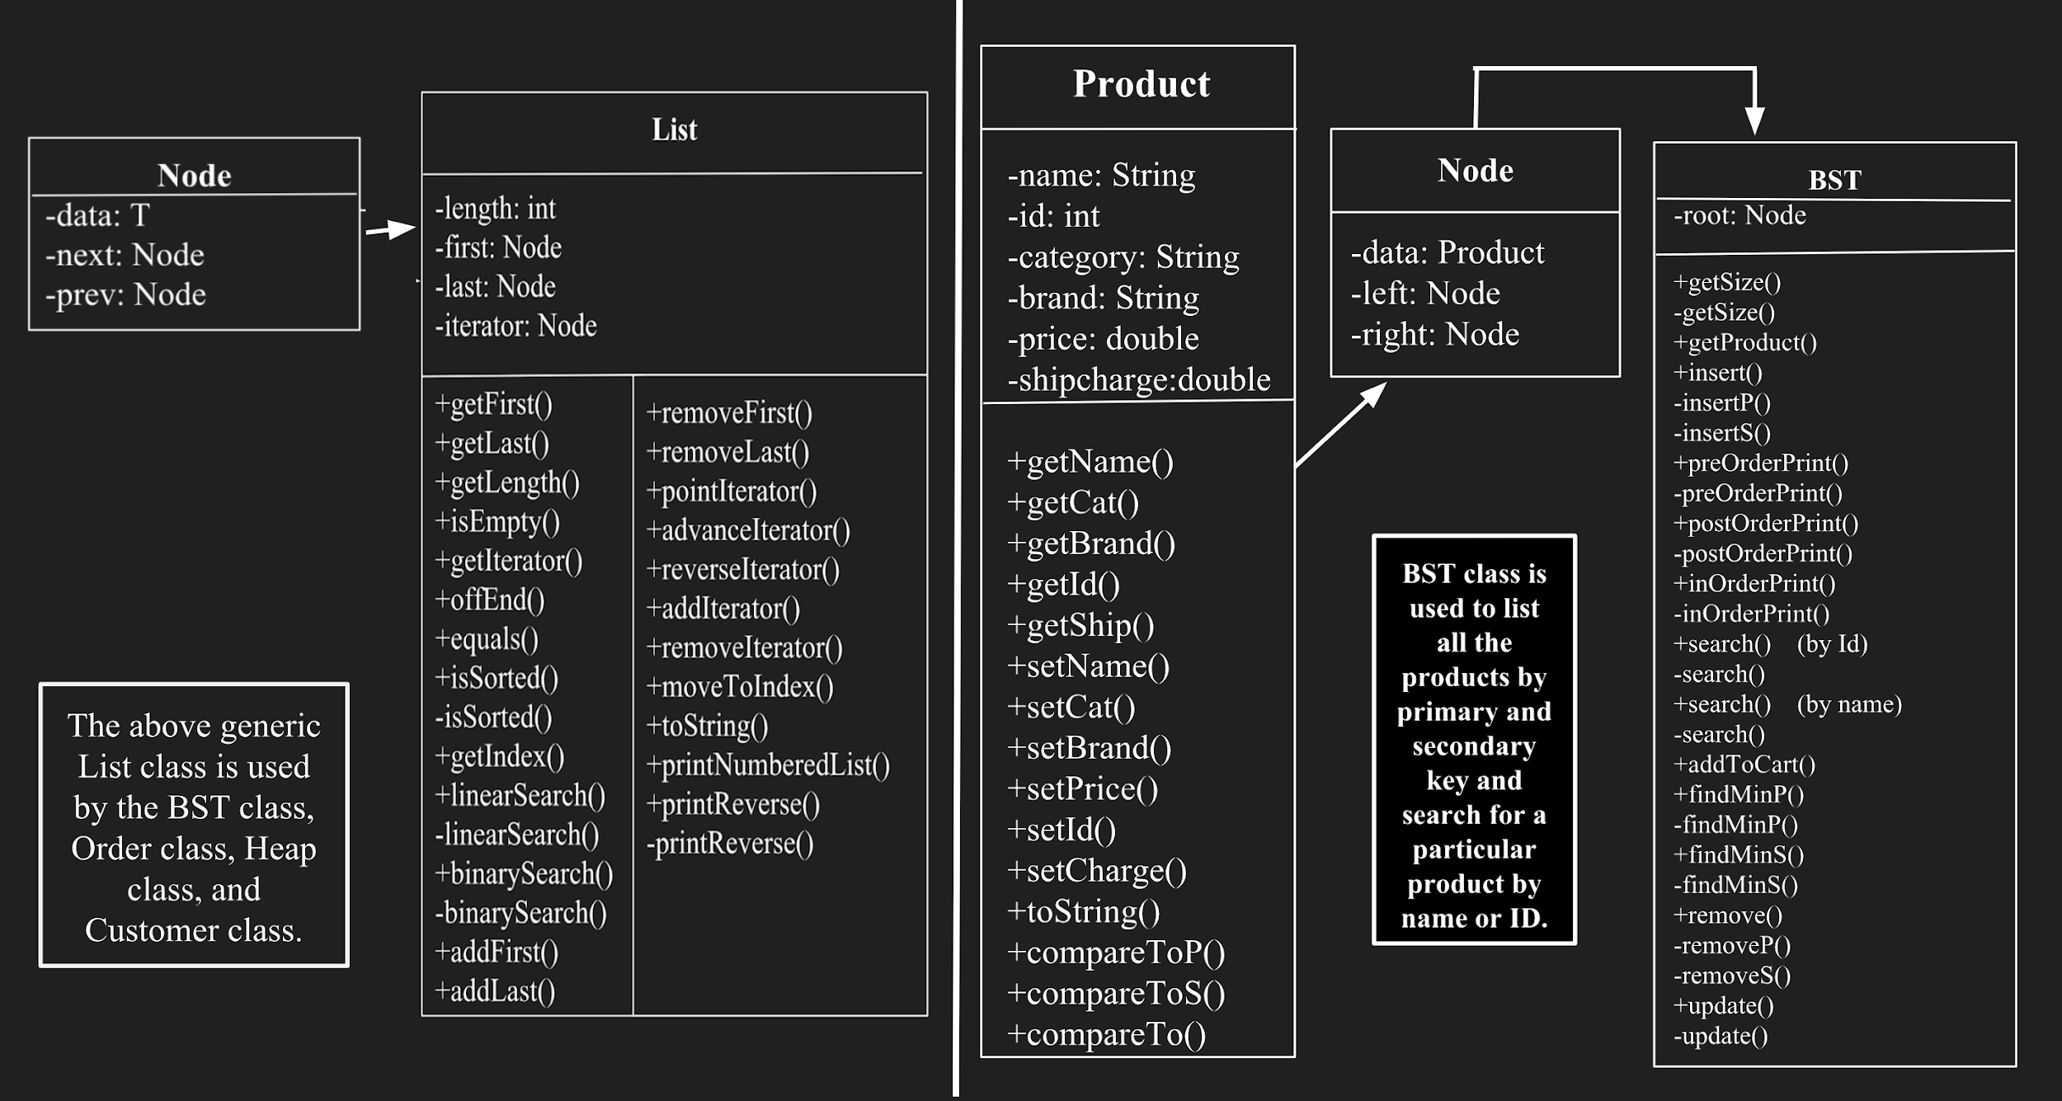
Data Structures and UML diagrams: Data Structure for Product

Slide 6
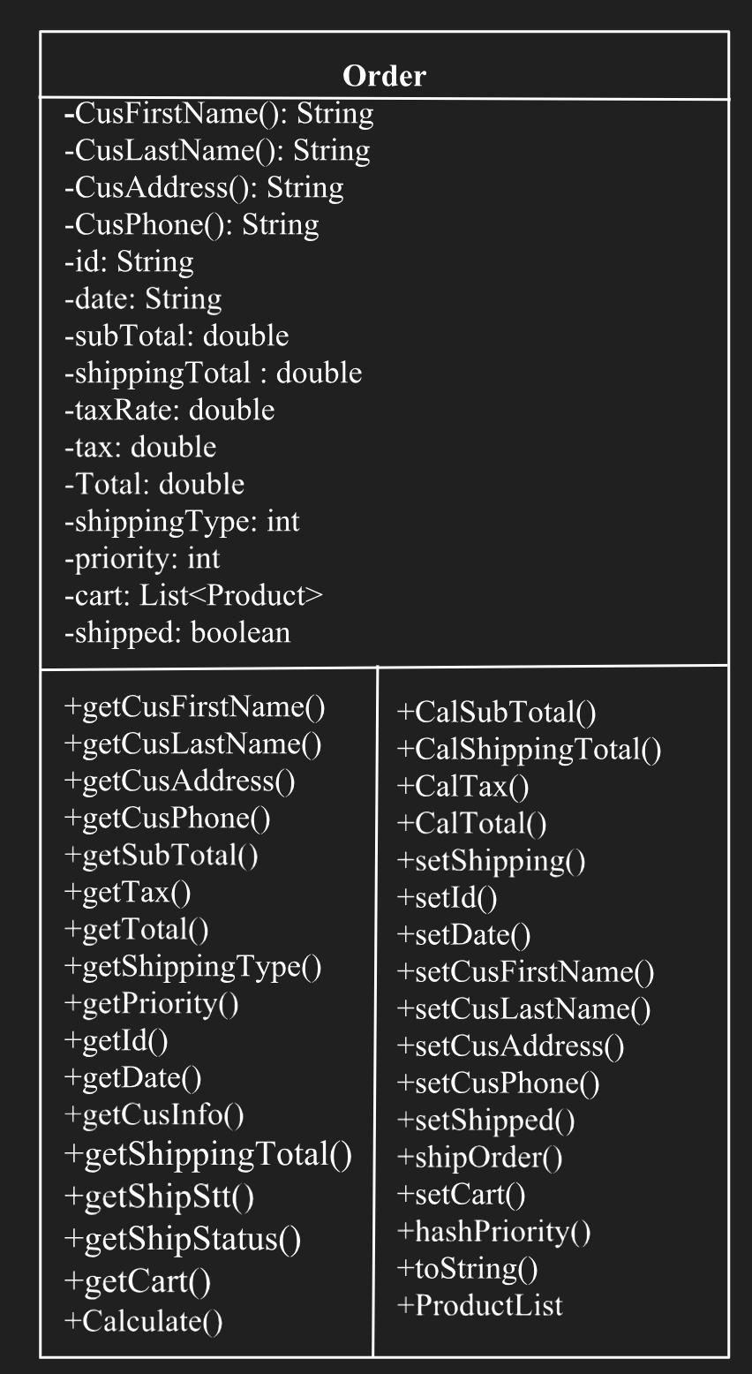
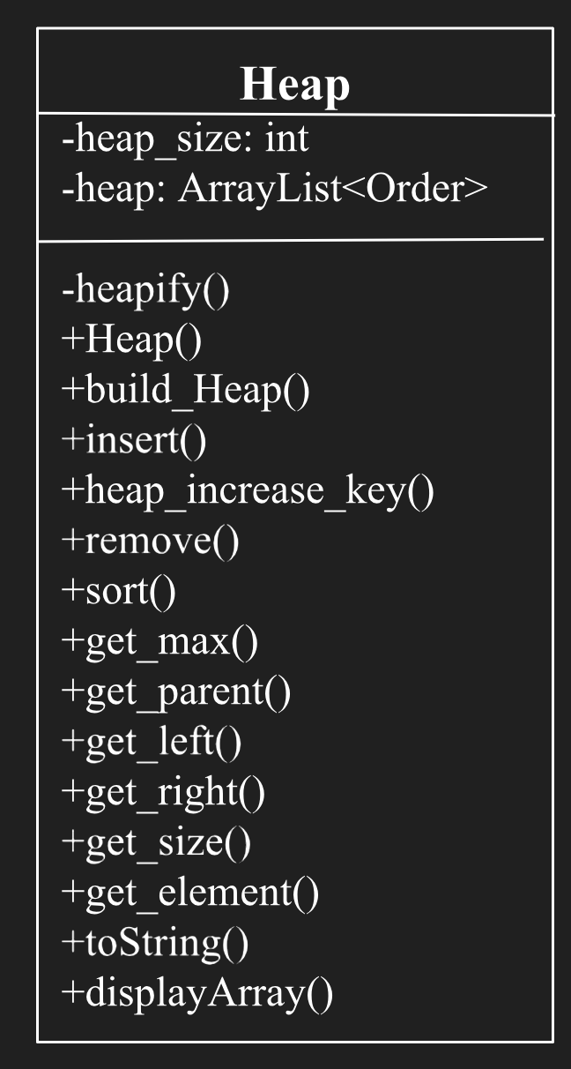
Data Structures and UML diagrams: Data Structure for Order

Slide 7
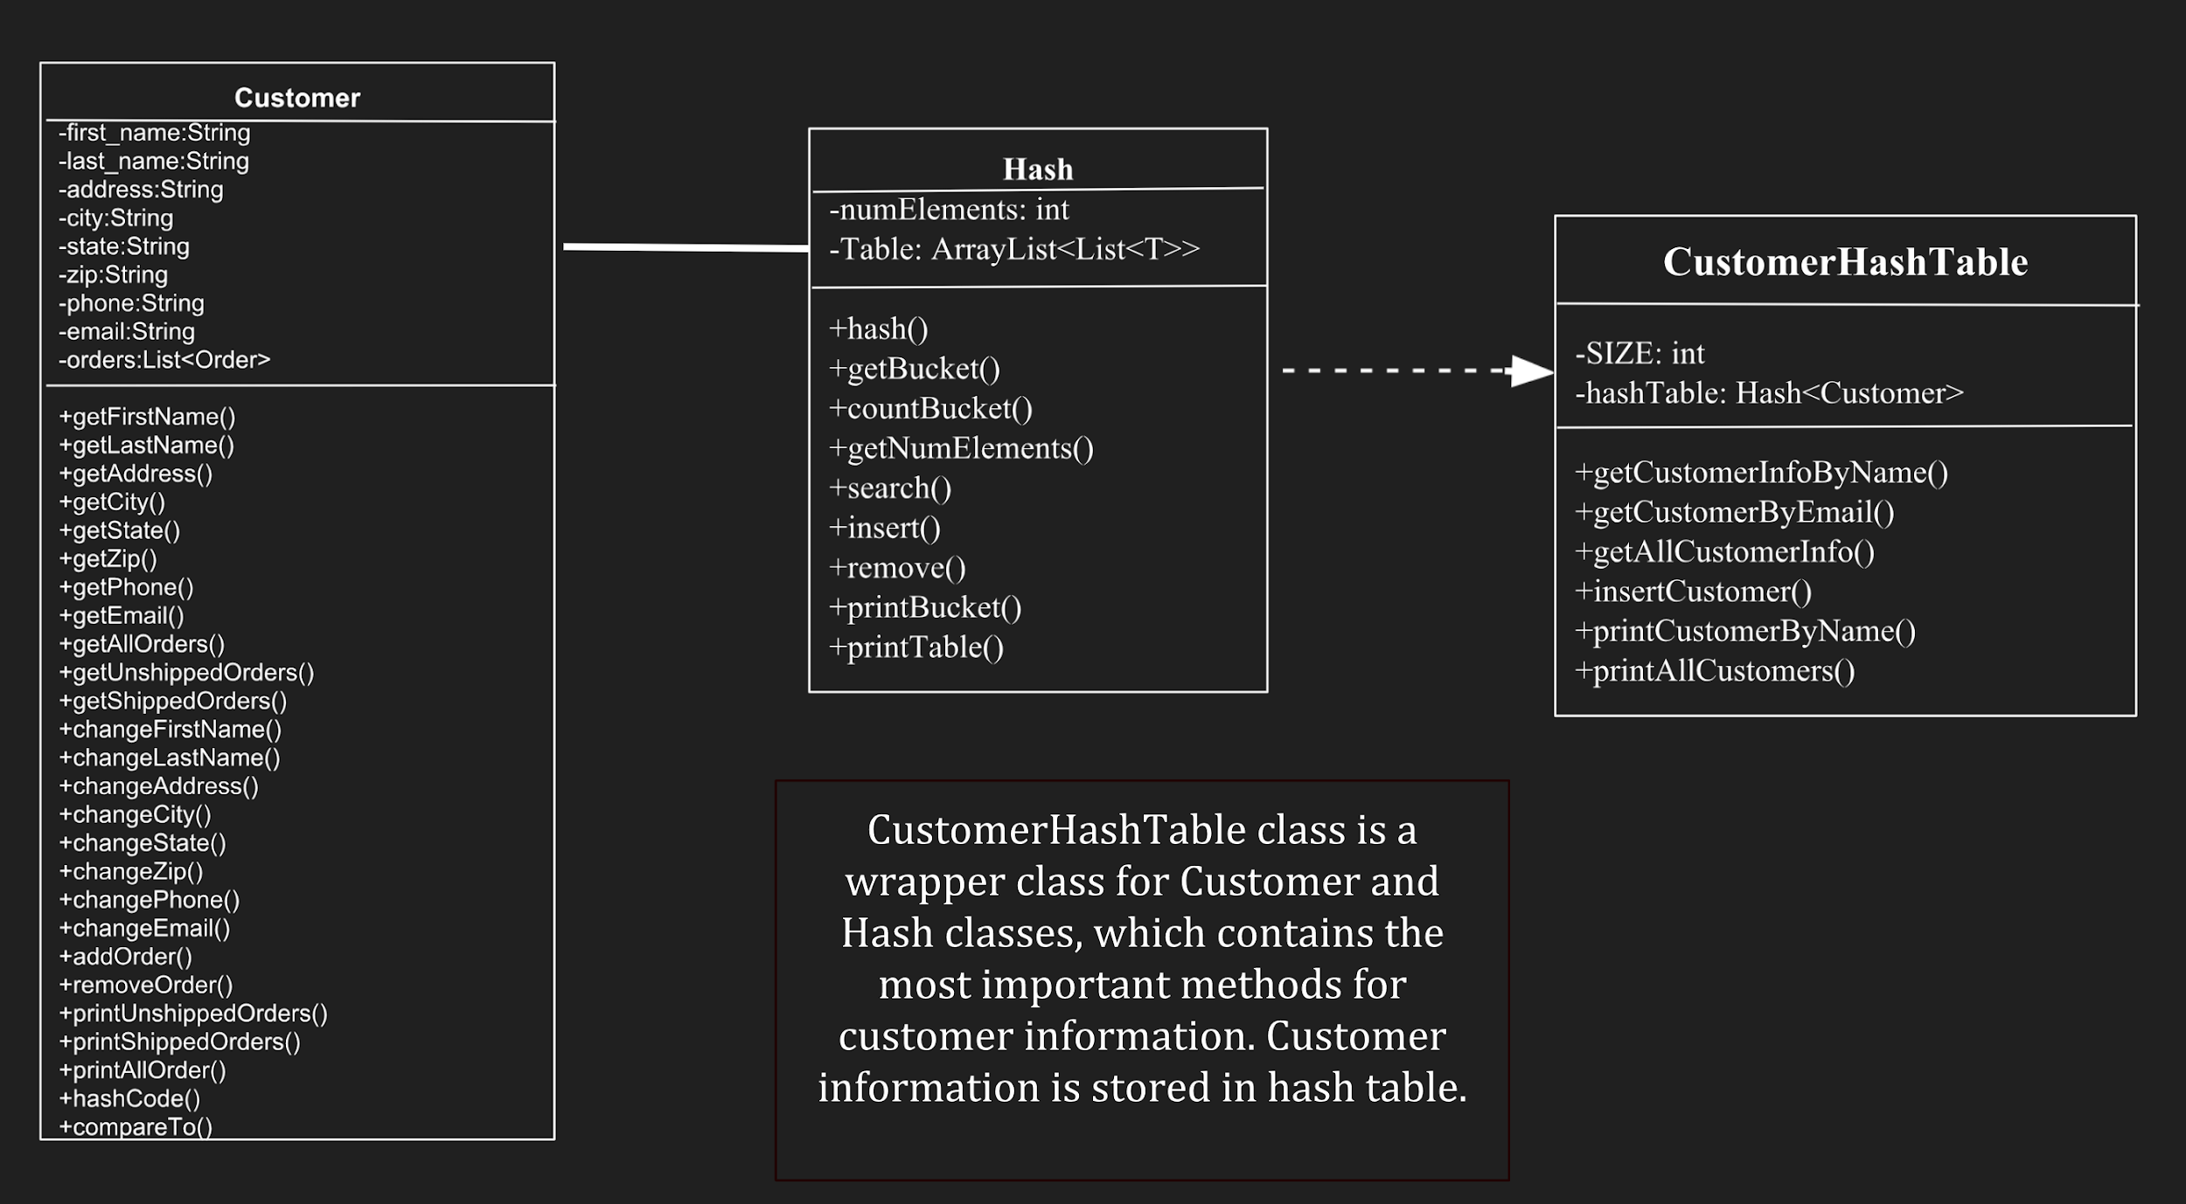
Data Structures and UML diagrams:Data Structure for Customer
0..*
+addOrderForCus()

Slide 8
Results and Modifications from BETA testing:
Feedback 1:
Name: Aditya Vishwakarma
Major: Business
Feedback: First of all, I was amazed to see the app that my friends have made. I also have taken two classes in Computer Science but haven't made any project at this scale.
Pros:
The app was easy to use, from making a account to logging out everything seemed to flow together.
Initially I thought the console User Interface would be a nightmare but on the contrary the user interface was a fairly easy way to order items of my choice.
Ordering items, getting shipping information, and almost everything was upto the mark.
Things to consider:
Try making input descriptions more self explanatory.
Feedback 2: My name is Junpeng Li. I tried this program as a new customer. The program asks me for some information for signing up, then brings me back to main menu. After I am back to the main menu, I sign in as an existing customer. The program is easy to use even if I am not a CS student. It is a lot of fun to play with it. It is kind of semi-online shopping site.

Slide 9
Results and Modifications from BETA testing:
ERRORS discovered:
Not being able to link heap and hash.
Try making input descriptions more self explanatory.
Phone number validation while asking user for input.
After USER entered wrong password he should be asked again to log in.
A few spelling errors.
Hard to get back to main menu after registering.
A small error in getting shipping details.

Slide 10
Results and Modifications from BETA testing:
Modifications:
After the BETA testing, we tried to fix all the issues that we had discovered.
The application became more self explanatory.
Small errors and details were handled in a proper manner.
Easy to use and smoothly flowing User Interface.
Efficiency and effectiveness of the project increased.

Slide 11



Slide 12

Team:
Bhargavi Kumar Sundaresan
Le Minh Long Nguyen
Sarthak Agarwal
Xin Xin
Yunlin Xie

